Slide 1
BCA Final Year Project (Review II)
AI POWERED CHATBOT FOR PSYCHOLOGICAL FIRST AID AND SUPPORT
Submitted to the Presidency University, Bengaluru in partial fulfilment for the award of the degree of Bachelor of Computer Applications(BCA)
Project Team No : BCA_MP_89
Name | Roll Number
SREEHARI NK | 20231BCD0045
ASWIN PV | 20231BCD0003
GHANSYAM PAL | 20231BCD0052
MOHAMMAD SHAZIL C | 20231BCD0087
Under the supervision of
Mr. Akshay Dilip Palve
Assistant Professor
School of Computer Science and Engineering
1

Slide 2
Content
Problem Statement
Literature Review
Module Design
Tools and Technologies Used
GitHub Link
Timeline of the Project
References

Slide 3
Problem Statement
Students frequently experience emotional challenges due to:
Academic stress
Anxiety before examinations
Lack of emotional support
Hesitation to seek professional help
Limitations of Existing Systems
Many chatbots depend on internet APIs
Require large computational resources
Focus mainly on conversation rather than practical help

Slide 4
Problem Statement
Proposed Solution
Develop a lightweight AI chatbot that:
Detects emotions from user text
Provides instant coping suggestions
Works without external AI APIs
Operates with a locally trained ML model

Slide 5
Literature Review
Areas Studied
Emotion detection using Natural Language Processing
Mental health support chatbots
Lightweight machine learning models for text classification
Key Observations
Many chatbots rely on large AI APIs
Emotion detection commonly uses TF-IDF based ML models
Most systems focus on conversation rather than practical solutions

Slide 6
Literature Review
Conclusion
A hybrid approach (Machine Learning + Rule-based responses) is suitable for:
Faster response
Offline capability
Simpler system implementation

Slide 7
Module Design
Module 1 — User Interface (Frontend)
Built using HTML, CSS, JavaScript
Provides login system and chat interface
Displays user messages and chatbot responses
Module 2 — Backend Server
Built using Node.js and Express.js
Handles authentication (/login)
Processes chat requests (/chat)
Connects frontend with the ML model

Slide 8
Module Design
Module 3 — Emotion Detection Model
Implemented using Python
Uses machine learning for text emotion classification
Predicts emotion + confidence score
Example: stress | 0.72
Module 4 — Response Engine
Rule-based suggestion system
Maps detected emotion → coping suggestions
Provides practical mental health guidance
Example: Stress → break tasks + short study breaks

Slide 9
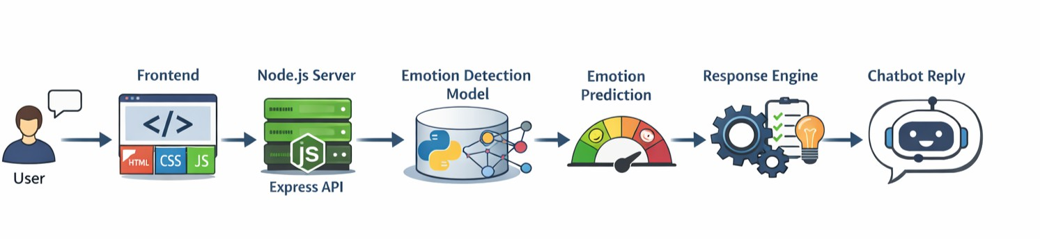
System Architecture

Slide 10
Tools And Technologies To Be Used
Frontend
HTML
CSS
JavaScript
Used to create the chat interface and user interaction.
Backend
Node.js
Express.js
Used to handle API requests and connect frontend with the ML model.

Slide 11
Tools And Technologies To Be Used
Machine Learning
Python
Scikit-learn
Pandas
Used to train and run the emotion detection model.
Other Tools
Joblib – used to save the trained model
Git & GitHub – version control and project repository
VS Code – development environment

Slide 12
Tools And Technologies To Be Used
Database
Not used currently
Simple authentication system implemented

Slide 13
Github Link
https://github.com/hareeeeey/mindcare

Slide 14
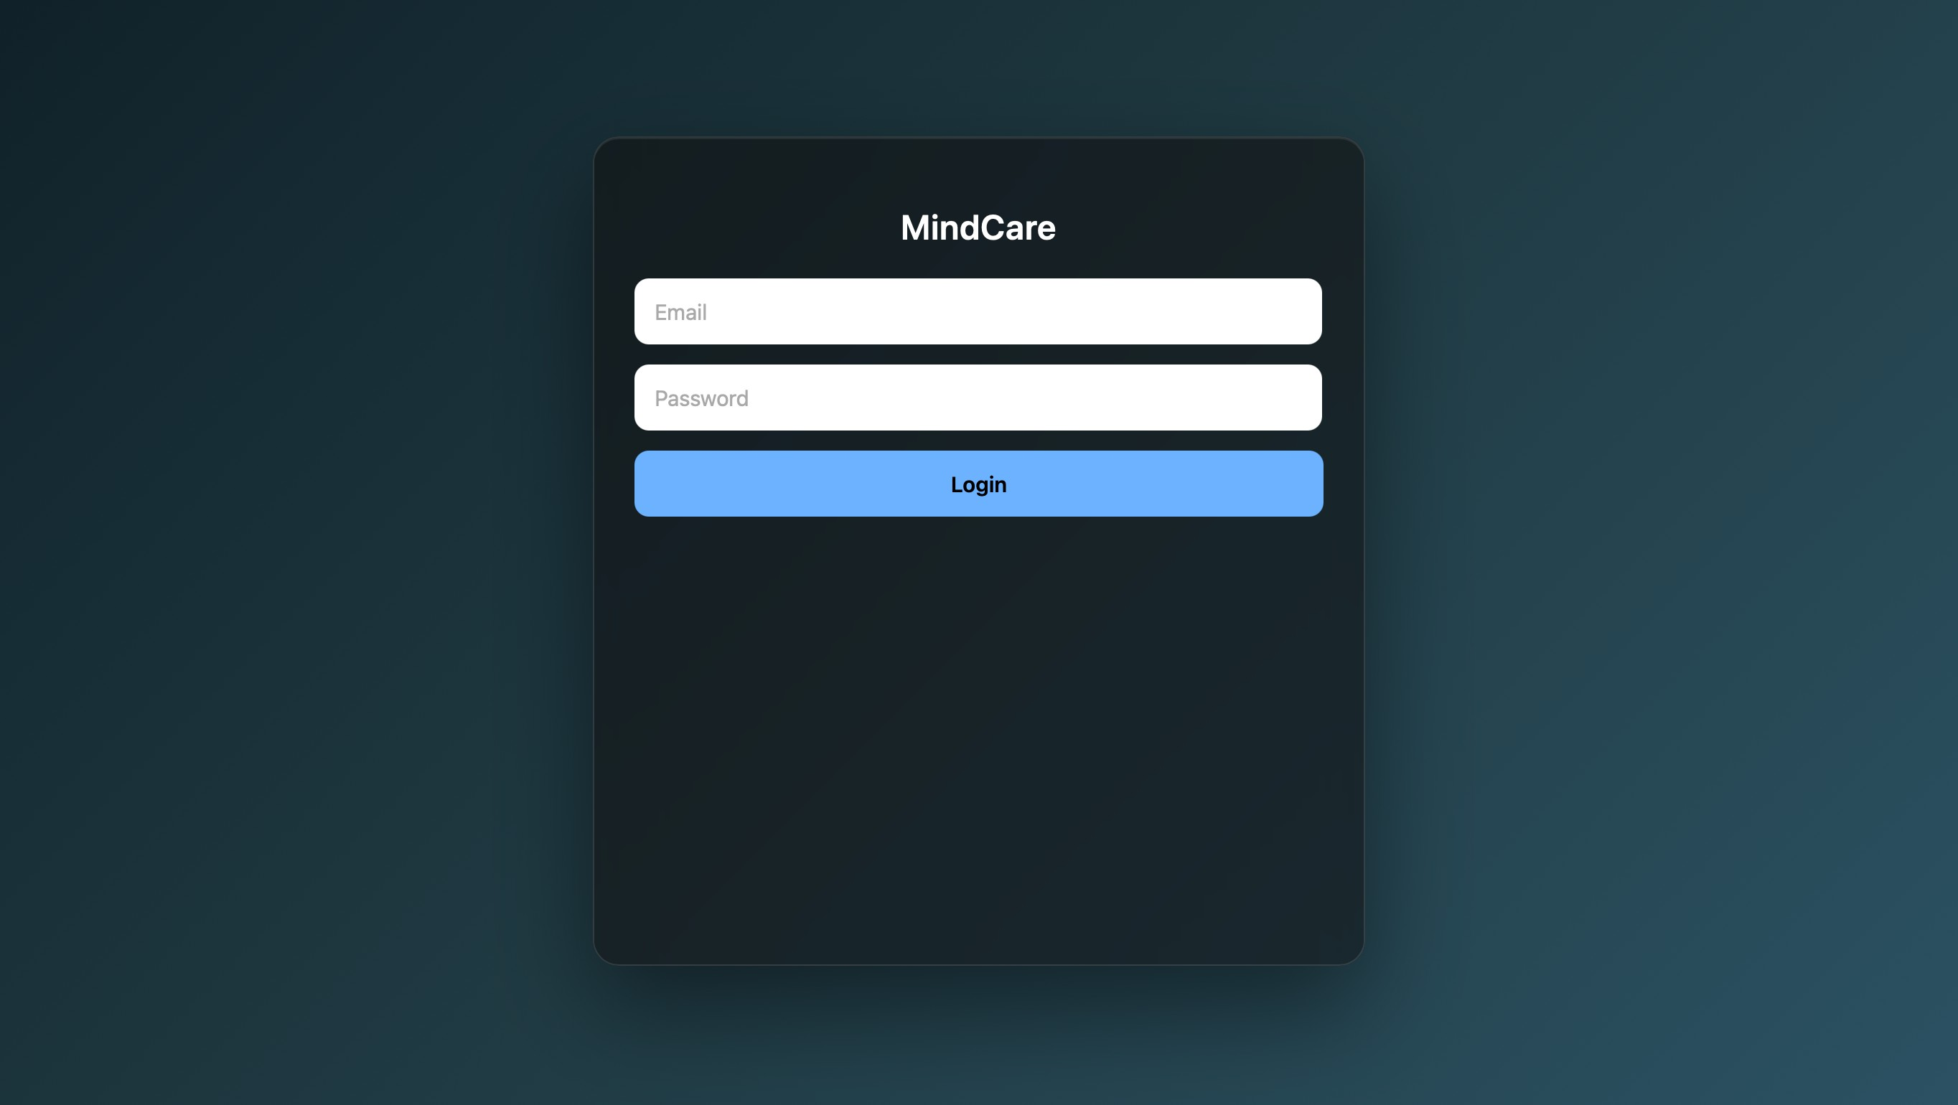
System Demonstration
Login page

Slide 15
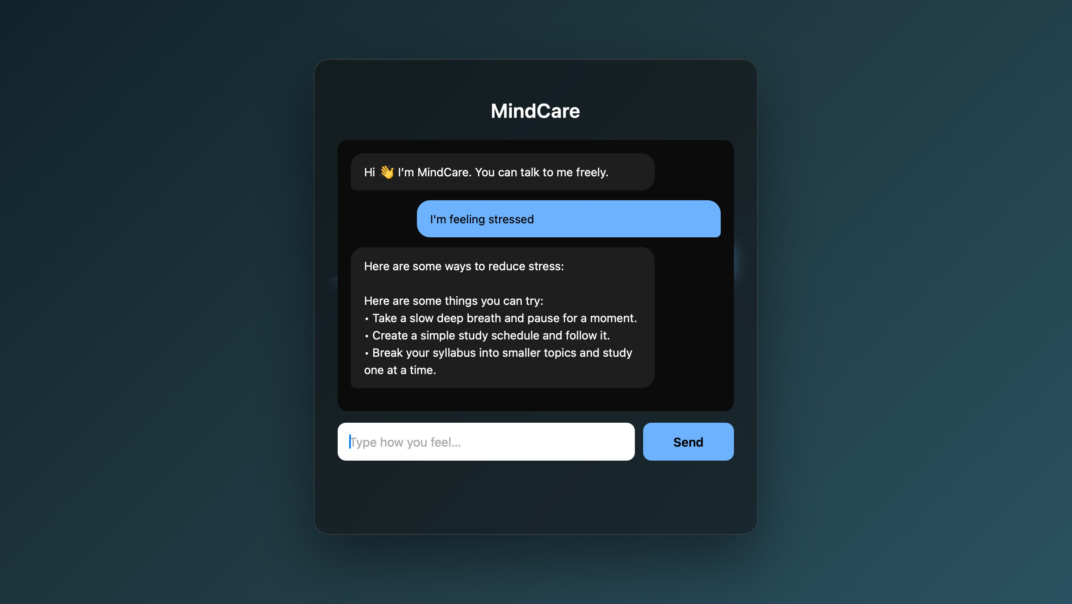
System Demonstration
Main chat page

Slide 16
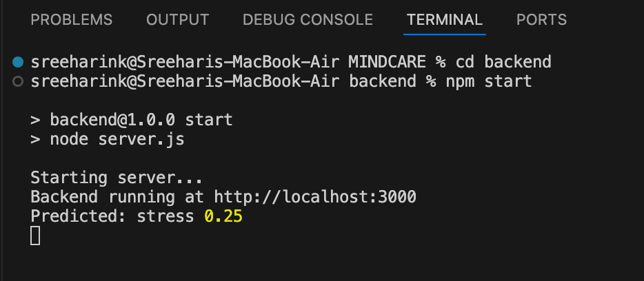
System Demonstration
Emotion Detection with confidence score in VS Code Terminal

Slide 17
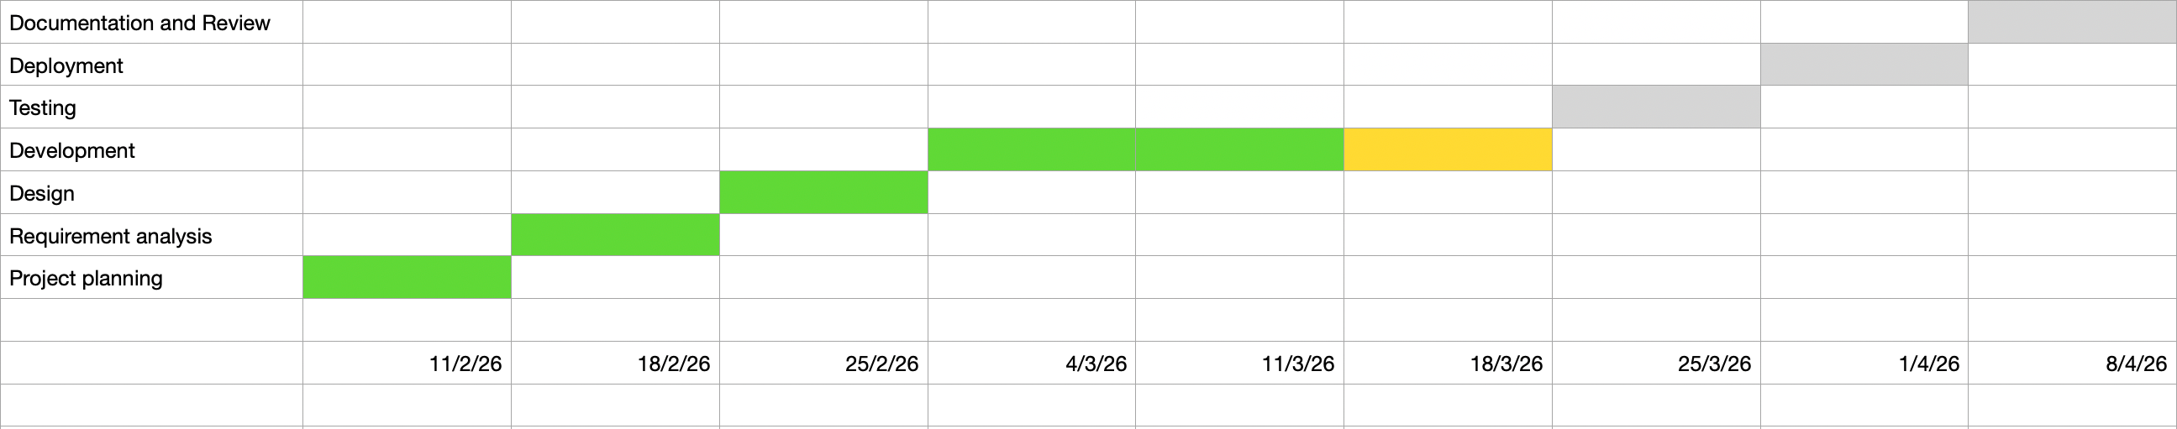
Timeline of the Project (Gantt Chart)

Slide 18
Timeline of the Project (Gantt Chart)
Phase 1 — Completed
Project setup
Frontend chat interface development
Backend server setup
Phase 2 — Completed
Emotion detection ML model development
Integration of ML model with backend
Implementation of basic response engine

Slide 19
Timeline of the Project (Gantt Chart)
Phase 3 — In Progress
Dataset expansion (~1000 samples planned)
Improving prediction accuracy
Adding more emotion response suggestions
Phase 4 — Upcoming
UI improvements
Final system testing
Project documentation and deployment
Add conversational intent detection

Slide 20
References (IEEE Paper format)
Fitzpatrick, K. K., Darcy, A., & Vierhile, M. (2017).
Delivering Cognitive Behavioural Therapy to Young Adults With Symptoms of Depression and Anxiety Using a Fully Automated Conversational Agent (Woebot).
Jurafsky, D., & Martin, J. H. (2023).
Speech and Language Processing.
Pedregosa, F. et al. (2011).
Scikit-learn: Machine Learning in Python.
Node.js Official Documentation
Python Software Foundation Documentation

Slide 21


